Slide 1
Data Science in Practice
Basketball Semi-finals popularity Analysis using Reddit Data

Slide 2
Introduction
Every year in NBA two conference finals and 1 Final are held
A data dump from reddit was provided comprised all comments from may 2015
In that period the conference finals happened
In this project
We will look at those events from the perspective of the redditors
Based on their flairs and comments(during that time window)
Level of engagement/support towards their teams
Sentiment expressed

Slide 3
NBA
The 2014–15 NBA season was the 69th season of the National Basketball Association (NBA).
The 2015 NBA playoffs began on Saturday, April 18, 2015 and concluded with the 2015 NBA Finals which began on June 4, 2015 on ABC.
ESPN broadcast the Western Conference Finals and TNT televised the Eastern Conference Finals.
ABC broadcast the NBA Finals.
Redditors posted comments on the events and stars

Slide 4
 | First Round |  |  |  |  | Conference Semifinals |  |  |  |  | Conference Finals |  |  |  |  | NBA Finals
 | 1 | Atlanta* | 4
 | 8 | Brooklyn | 2
 |  |  |  |  |  | 1 | Atlanta* | 4
 |  |  |  |  |  | 5 | Washington | 2
 | 4 | Toronto* | 0
 | 5 | Washington | 4
 |  |  |  |  |  |  |  |  |  |  | 1 | Atlanta* | 0
 | Eastern Conference
 |  |  |  |  |  |  |  |  |  |  | 2 | Cleveland* | 4
 | 3 | Chicago | 4
 | 6 | Milwaukee | 2
 |  |  |  |  |  | 3 | Chicago | 2
 |  |  |  |  |  | 2 | Cleveland* | 4
 | 2 | Cleveland* | 4
 | 7 | Boston | 0
 |  |  |  |  |  |  |  |  |  |  |  |  |  |  |  | E2 | Cleveland* | 2
 |  |  |  |  |  |  |  |  |  |  |  |  |  |  |  | W1 | Golden State* | 4
 | 1 | Golden State* | 4
 | 8 | New Orleans | 0
 |  |  |  |  |  | 1 | Golden State* | 4
 |  |  |  |  |  | 5 | Memphis | 2
 | 4 | Portland* | 1
 | 5 | Memphis | 4
 |  |  |  |  |  |  |  |  |  |  | 1 | Golden State* | 4
 | Western Conference
 |  |  |  |  |  |  |  |  |  |  | 2 | Houston* | 1
 | 3 | L.A. Clippers | 4
 | 6 | San Antonio | 3
 |  |  |  |  |  | 3 | L.A. Clippers | 3
 |  |  |  |  |  | 2 | Houston* | 4
 | 2 | Houston* | 4
 | 7 | Dallas | 1

Slide 5
Data
The dataset is comprised of 54.504.410 comments,
a fraction of all comments made on reddit during the month of May 2015 available publicly,
organized in a single table ‘May2015’ and provided by (Kaggle, 2015) .
Each row in the table May2015 represents a single comment,
With the following attributes:
("gilded","author_flair_text","author_flair_css_class","retrieved_on","ups","subreddit_id","edited","controversiality","parent_id","subreddit","body,"created_utc","downs","score","author","archived","distinguished","id","score_hidden","name","link_id").

Slide 6
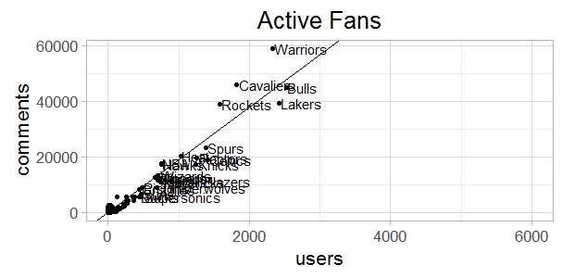
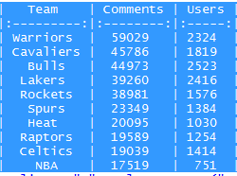
Summary & User Engagement

Slide 7
Analysis
What Happened in
Eastern/Western Confence Finals
2015-05-19, Rockets 106 - 110 Warrior
2015-05-20, Cavaliers 97 - 89 Hawks
2015-05-21, Rockets 98 - 99 Warriors
2015-05-22, Cavaliers 94 - 82 Hawks
2015-05-23, Warriors 115 - 80 Rockets
2015-05-24, Hawks 111 - 113 Cavaliers
2015-05-25, Warriors 115 -128 Rockets
2015-05-26, Hawks 88 - Cavaliers 118
2015-05-27, Rockets 90- 104 Warriors
How was it reflected on Reddit
Comment volume
Rocket>Warriors>Hawks>Cavaliers
Cavaliers=Hawks>Rockets>Warriors
Rockets>Warriors>Cavaliers=Hawks
Cavaliers>Hawks>Warriors>Rockets
Warriors>Rockets=Cavaliers>Hawks
Cavaliers>Hawks>Warriors>Rockets
Rockets>Warriors>Cavaliers>Hawks
Cavaliers>Hawks>Rockets>Warriors
Warriors>Rockets>Cavaliers>Hawks

Slide 8
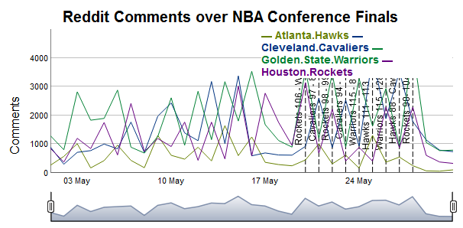

Slide 9
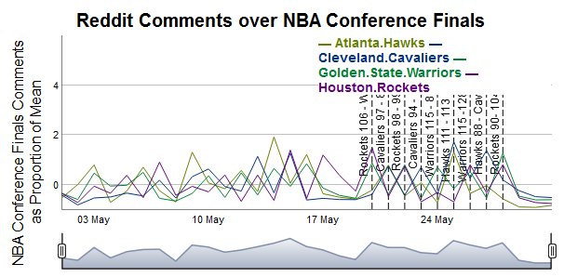

Slide 10
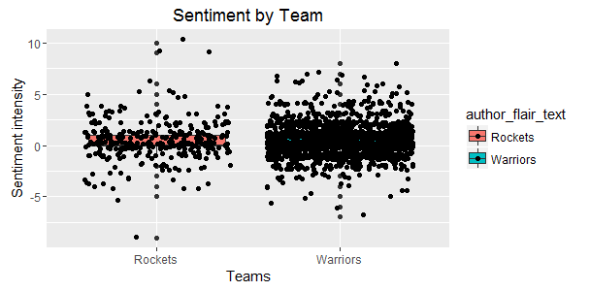

Slide 11
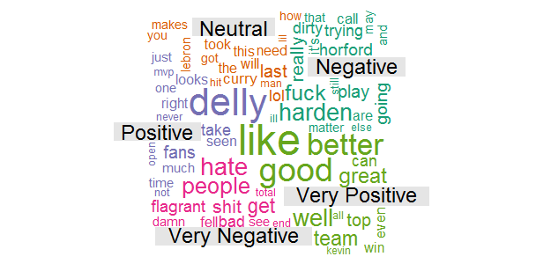

Slide 12
Conclusion
Overall intensity engagement for the period do not strictly match
Winning a game did not imply getting more comments
Are flairs enough to catch that correlation?
Attempt to work with flairs matching individual players
Player/comments volume not satisfactory
Skewed distribution
For future improvement get the team/players differently
By reading the comment body
Using their alias

